Slide 1
Syngenta Crop Protection, LLC
ARC Application Implementation Kickoff
Aligning on outcomes, team, and how we’ll deliver.
10/26/2026

Slide 2




What we’ll accomplish together
WHY WE'RE HERE TODAY
Meet your team
The people delivering your project, their roles, and your single point of contact.
Align on success
Confirm why we’re doing this project and what a successful outcome looks like in your words.
Agree how we’ll work
Cadence, communication, transparency, and how we handle change and escalation.
Confirm next steps
What happens in the next week, and what we’ll each own.
Notes:
Table Slides
Severity

Slide 3





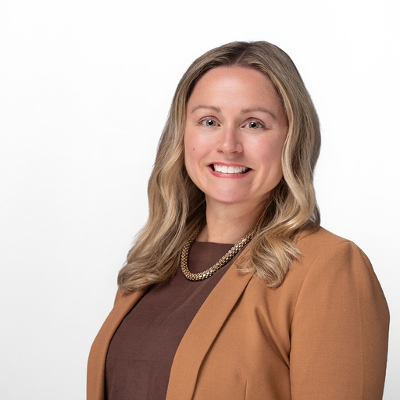
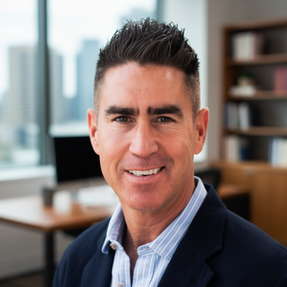


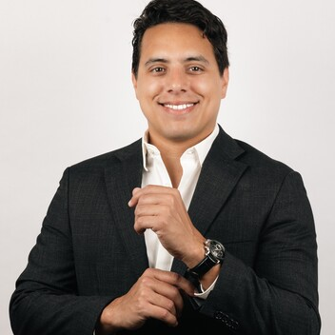
The people delivering your project
YOUR TEAM
Rodney deJong
Matheus Mansour El Batti
Kranth Kumar
Project Manager
QA Engineer
America - Vancouver
Full Stack Developer
Asia - Kolkata
America - Sao Paulo
Lindsey Kanturek
Ryan Gramm
Saadia Iqbal
Senior Client Partner
Senior Sales Executive
Delivery Manager
America - Chicago
America - Phoenix
America - Dallas
James Mora
Gustavo Granados
PMO Portfolio Lead
Enterprise Account Manager
America - Philadelphia
America - San Jose
Notes:
Table Slides
Severity

Slide 4
Alignment

Slide 5


Why we’re here
PROJECT SUCCESS AGREEMENT
Our draft understanding — please confirm, correct, or add.
Why are we doing this?
Toptal and Syngenta are building the ARC application to bring research data from several separate systems into one searchable tool, and to migrate the older MTA Store so it can be switched off. ARC is one application within a larger Syngenta platform that is built so more research tools can be added later.
What problem are we solving?
The research data ARC uses comes from five separate systems, and trait names differ between them. ARC brings this data into one place with consistent trait names and fast search, and lets scientists compare results with a newer view that looks across many crop varieties.
What does success look like?
Scientists can search the combined data in one place, with 95% of searches returning in under three seconds. The MTA Store is switched off once ARC matches its features. To achieve this outcome, the project is delivered over four milestones over an estimated 26 weeks, passes its launch checks, and delivers training materials and user documentation.
Notes:
Walk each answer aloud and ask the client to confirm or correct. Capture changes live. This is where alignment actually happens — do not rush it. Anything that shifts scope, timeline, or the exclusions gets logged; the PM codifies the final wording with the sponsor after kickoff and secures approval before Discovery.

Slide 6
Four milestones delivered over 26 weeks
+ 4 weeks of Hypercare
Solution Overview
PROJECT SUCCESS AGREEMENT
Syngenta owns the platform layer (Terraform, infrastructure).
Toptal owns Arc development.
Syngenta also holds the data tier, which is where the ingestion pipelines and the Snowflake model sit.
Toptal holds the application: the shell, the ARC micro-frontend, the FastAPI services, and the nomenclature service.
Arc is one application inside a larger Syngenta platform.
Workstream / Feature Set
Deliverables Summary
Micro-frontend Shell
Azure AD / MSAL Authentication Integration
Shell and Authentication E2E Test Harness
Authentication Negative Tests and Security Scan
P1 Syngenta-Built Component Certification Tests
Deliverables
P1 Foundation 6 weeks
Toptal stands up the shell and sign-in. Syngenta stands up the platform and the empty Snowflake schema.
7
Faceted Search and Detail API Endpoints
Asynchronous Long-Running Query Processing
Backend Load Tests and Performance Engineering Spike
OneGWAS Direct-Write Integration and Tests
Data Ingestion and Content Certification Tests
P2a Services and Data 10 weeks
Toptal builds the API layer and the OneGWAS writer. Syngenta loads the data.
11
P2b Application Surface 5 weeks
ARC Faceted Search, Results Table and Detail View
Haplotype Search, Visualization and API
Nomenclature Service
P2b Frontend, Haplotype and Nomenclature Test Suites
Toptal builds the scientist-facing screens, haplotype APIs and trait-name resolution. Syngenta builds the Haplotype schema extensions.
10
Toptal Out of Scope:
Platform (Terraform, Infrastructure)
Data-Tier (Snowflake, Ingestion)
Syngenta-Built Defect Remediation
Production Deployment
Launch Integration, Performance, Security and Cross-Browser Test Suites
UAT Execution Records and Defect Log
Pre-Launch Hardening Iteration
Production Smoke Tests and 48-Hour Defect Watch
MTA Store Parity and Usage-Zero Confirmation Report
Training Materials and User Documentation
P3 Launch week 5 weeks
Toptal tests everything end to end. Syngenta deploys to production and retires the MTA Store.
7
Notes:
Certification Acceptance - measures a component built by Syngenta using test scripts and issuance of defect report
Latency Acceptance - Latency and render-time Acceptance Criteria measure Toptal-built components running on Syngenta platform components.

Slide 7
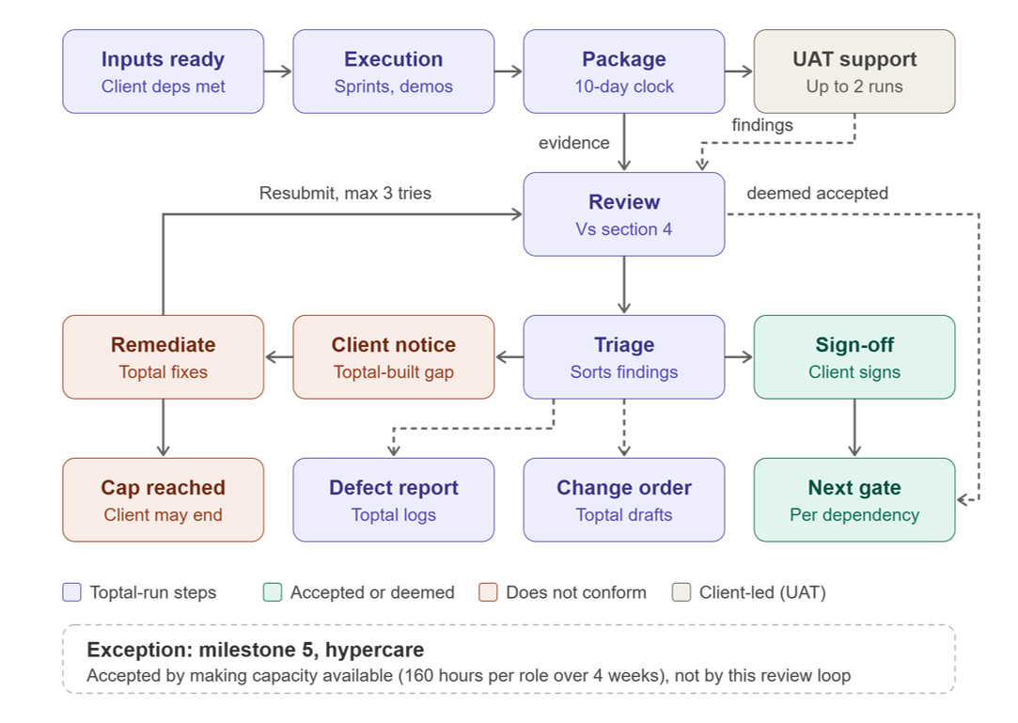
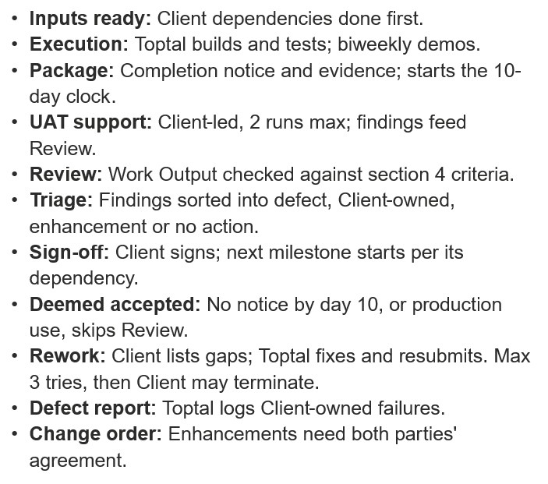
How milestone acceptance works
PROJECT SUCCESS AGREEMENT
Notes:
Main track
Inputs ready (Client deps met). The Client’s work must be done before the Toptal work that depends on it can start. That covers Client-owned stories and code dependencies, the dev, staging and production environments, design system access, and people like the scientist UAT groups and the identity provider team. If any of it is late, it’s treated as a delayed Client dependency, and a change order can adjust schedule and fees. (Exhibit A §6–7)
Execution (sprints, demos). Toptal builds the Toptal-built components and writes and runs the automated test scripts, including those for Client-built “Certification” items. It follows the §5.1 cadence: kickoff, biweekly sprint demos, daily standups with the Client team, and a Weekly Status Report. (SOW)
Package (10-day clock). Toptal gives notice that the milestone’s Work Output is complete, and the Client’s 10-business-day acceptance period starts (§7). The notice is in the SOW. Bundling it with evidence as a formal package is your process.
UAT track (gray, parallel)
UAT support (up to 2 runs). Scientist groups test from a user’s point of view. UAT is included in the fixed price, capped at 2 runs per milestone, and covers all UAT, not only Toptal-built work. The Client coordinates and signs off on UAT (HS-4827), so Toptal takes part and tracks defects. Only Milestone 4 gives UAT a Work Output (HS-4828). It feeds Review as findings, but the SOW doesn’t say that, and that link is your process.
Review and sorting
Review (vs. section 4). This is the Milestone Acceptance Review from Exhibit A §5.1. It compares the Work Output to each story’s Acceptance Criteria in §4, using the “materially conforms” test from §7. It takes two inputs: evidence from the Package and findings from UAT. (SOW for the review and the test; the two-input design is yours)
Triage (sorts findings). This is your process, and it carries the most weight. Each finding goes one of four ways:
Conforms. It goes to Sign-off.
A Toptal-built failure against a stated criterion. It goes to Client notice and the rework loop.
A failure in a Client-built or Client-owned component. It goes to the Defect report. For Latency and Certification criteria the SOW says this doesn’t count against Toptal’s Work Output.
An enhancement or new requirement. It goes to Change order. The SOW says changes to requirements aren’t defects (§8, Exhibit A §2.5).
Accepted path
Sign-off (Client signs). The Client signs and delivers a certification of milestone acceptance through its designated approvers (§7). Toptal prepares the document under your process.
Next gate (per dependency). The next milestone can start, with a different trigger for each:
P2a starts when HS-4781, a Client-owned story, is complete.
P2b starts when P2a is accepted.
P3 starts when P2b is accepted.
Hypercare starts on the later of production go-live and M4 acceptance.
Deemed accepted (dashed arrow from Review). If the Client sends no written notice of failure within the 10 days, or starts using the output in production or commercially, the milestone is deemed accepted. It skips Sign-off and goes straight to Next gate.
Rework path (coral)
Client notice (Toptal-built gap). The Client states in writing how the output fails to conform and what changes would bring it into conformance (§7).
Remediate (Toptal fixes). Toptal makes commercially reasonable efforts to fix the issue under the same milestone and resubmits. The loop back to Review is your process, since the SOW only says Toptal resubmits for acceptance.
Cap reached (Client may end). After 3 unsuccessful attempts, the Client may terminate under the Agreement. It’s the Client’s option, not automatic, and the Client pays amounts due or accrued through the termination date.
Toptal-run steps outside the review loop (purple)
Defect report (Toptal logs). Toptal produces and maintains the report. It records Client-owned failures and Latency misses traced to Client components. The Client remediates them. (§3–4)
Change order (Toptal drafts). The SOW has both parties negotiate in good faith and mutually agree (§8). It doesn’t say who drafts. Toptal drafting is your process.
Exception
Milestone 5, hypercare. It has no review loop. It’s accepted by making capacity available: 160 hours each for a Full-Stack Developer and a QA Engineer over 4 weeks.

Slide 8
Ways of Working

Slide 9
Our operating rhythm
WAYS OF WORKING
Our philosophy is no surprises by design.
DAILY
WEEKLY
MONTHLY
AD-HOC
Project team stand-ups
(15 mins)
Immediate tactical alignment, sharing of daily goals, and rapid unblocking of technical hurdles.
Status Report & Meeting (30-45 mins)
Review progress against milestones, review the RAID log, and align on cross-functional dependencies.
Steering Committee
(60 mins)
Review overall project health, approve major scope / budget changes, resolve escalated risks, and ensure continued strategic alignment.
Working Sessions / Demos
Detailed requirements gathering, technical solution design / reviews, process mapping, and targeted feedback.

Slide 10
Initial risk register
WAYS OF WORKING
Addressing the “elephants in the room” proactively to ensure effective kickoff
Risk Description | Prob/Impact | Proposed Mitigation Strategy | Target Resolution Date
Talent Team Access Delay Delayed AWS Workspaces and Tools access could block schedule progress and impact milestone gates. | Medium/High | Build in time for for access completion before Sprint 0 start in schedule | Before Sprint 0
Certification Targets (Toptal Test Script/Defect Report against Syngenta Components) Certification targets depend on Syngenta components so defects may not be fixable by Toptal and impact milestone gates. | Medium/High | Log failures in the defect report, agree remediation owners and timelines with Syngenta, and plan re-test windows. | Before Milestone 1 Acceptance Review
Latency Targets (Toptal Components running on Syngenta platform) Latency and render-time targets depend on Toptal and Syngenta components so performance misses may not be fixable by Toptal and impact milestone gates. | Medium/High | Use query observability to attribute misses early and log findings in the defect report. | Before Milestone 1 Acceptance Review
Design Requirements (Inputs ready) Delayed development inputs (design requirements, design system access, UI/UX designs and interface contracts) could impact milestone gates. | Medium/High | Identify and manage user story dependencies and escalate if user story progress is blocked. | Sprint Planning, Standups, Escalation
Notes:
Walk each answer aloud and ask the client to confirm or correct. Capture changes live. This is where alignment actually happens — do not rush it. Anything that shifts scope, timeline, or the exclusions gets logged; the PM codifies the final wording with the sponsor after kickoff and secures approval before Discovery.

Slide 11
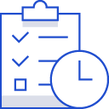

Managing Change
WAYS OF WORKING
How we handle new ideas without blowing up the budget and/or timeline.
How we keep you informed
How we handle change
A weekly status report with an honest health rating
Surface risks early and the risk and issues log is always accessible
New requirements are identified early, assessed for impact, then reviewed with stakeholders
Refinements within scope
We document and proceed — no friction, no delay.
Changes to scope, timeline, or budget
We pause, document the change and impact, then bring it to you — agreed together before any work begins.
Notes:
Walk each answer aloud and ask the client to confirm or correct. Capture changes live. This is where alignment actually happens — do not rush it. Anything that shifts scope, timeline, or the exclusions gets logged; the PM codifies the final wording with the sponsor after kickoff and secures approval before Discovery.

Slide 12
Housekeeping

Slide 13
Next Steps
PATH FORWARD
What needs to happen in the next few days.
Owner | Action | Due
Syngenta / Toptal | Complete Talent Team AWS Workspaces and Tools Access/Setup | Started
Syngenta / Toptal | Talent Team Technical Orientation | TBD
Toptal / Syngenta | Sprint 0 Planning | TBD
Notes:
Walk each answer aloud and ask the client to confirm or correct. Capture changes live. This is where alignment actually happens — do not rush it. Anything that shifts scope, timeline, or the exclusions gets logged; the PM codifies the final wording with the sponsor after kickoff and secures approval before Discovery.

